Slide 2
LO:
Use a capital letter for names of people, places, the days of the week, the months of the year and the personal pronoun ‘I’
I know that proper nouns need capital letters.
I know that the personal pronoun I is always a capital.

Slide 3
With your talking partner...
Where should we use capital letters in our writing?
Be ready to give your ideas!

Slide 4
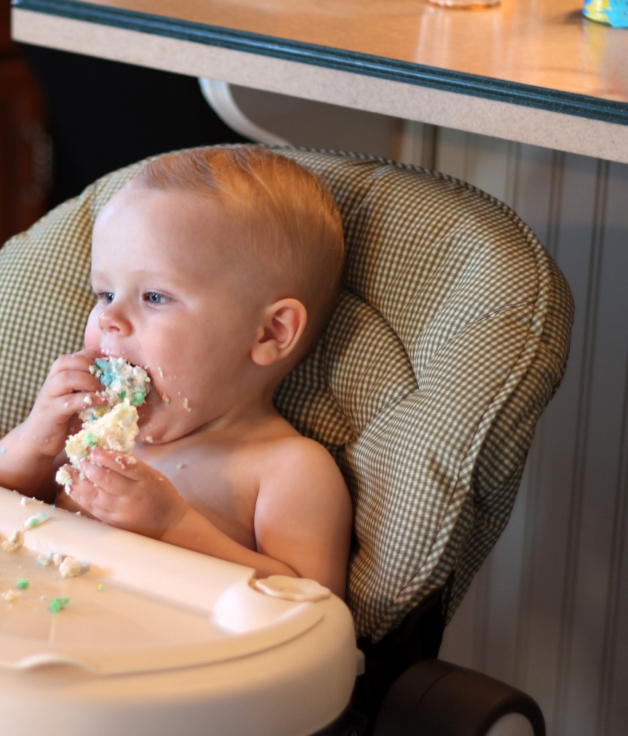
Starting Sentences
Capital letters are always used to start sentences
He loves to eat cake!
Photo courtesy of viviannguyen(@flickr.com) - granted under creative commons licence – attribution

Slide 5
Proper Nouns
Nouns are naming words.
Proper nouns are naming words for individual people, places, days of the week and months of the year.
Proper nouns all need capital letters.
Common Nouns | Proper Nouns
girl | Helen
country | England
city | Sheffield
football team | Nottingham Forest
day/month | Monday/September

Slide 6
Activity
Can you spot the proper nouns in these sentences and add
capital letters to the beginning of them?
Have a go on your whiteboard.
ben and susan went to australia for their holidays.
Ben and Susan went to Australia for their holidays.
owen supports hull city fc.
Owen supports Hull City FC.

Slide 7
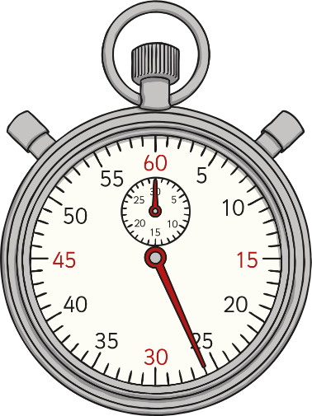
The Personal Pronoun ‘I’
When we are writing about ourselves we use the
personal pronoun ‘I’
I can tell the time.
The personal pronoun ‘I’ always needs a capital letter.

Slide 8
Now it’s your turn …
Add capital letters in the right places in these sentences.
Remember, the beginnings of sentences, proper nouns and ‘I’ need capital letters!
it is always snowing in iceland.
i like going to london.
mariam and sophia went to the shops in sheffield.
when i was a baby i didn’t have any teeth.
my brother zach and i watch football every saturday night.

