Slide 1
Disclaimer/s
We hope you find the information on our website and resources useful.
Animations
This resource has been designed with animations to make it as fun and engaging as possible. To view the content in the correct formatting, please view the PowerPoint in ‘slide show mode’. This takes you from desktop to presentation mode. If you view the slides out of ‘slide show mode’, you may find that some of the text and images overlap each other and/or are difficult to read.
To enter slide show mode, go to the slide show menu tab and select either from beginning or from current slide.
You may wish to delete this slide before beginning the presentation.

Slide 3
Consonants and Vowels
Vowels are the letters: a, e, i, o, u
and sometimes y.
a e i o u
Consonants are all the other letters,
such as: b, d, t, s, etc.
a b c d e f g h i j k l m n o p q r s t u v w x y z

Slide 4
Rule
If a word has a short vowel with only one consonant after it, then double the consonant in the spelling.

Slide 5
Short Vowel Sounds With
One Consonant
lap
lap
p
ed
lapped
beg
beg
g
ed
begged
sip
sip
p
ed
sipped
nod
nod
d
ed
nodded
tug
tug
g
ed
tugged

Slide 6
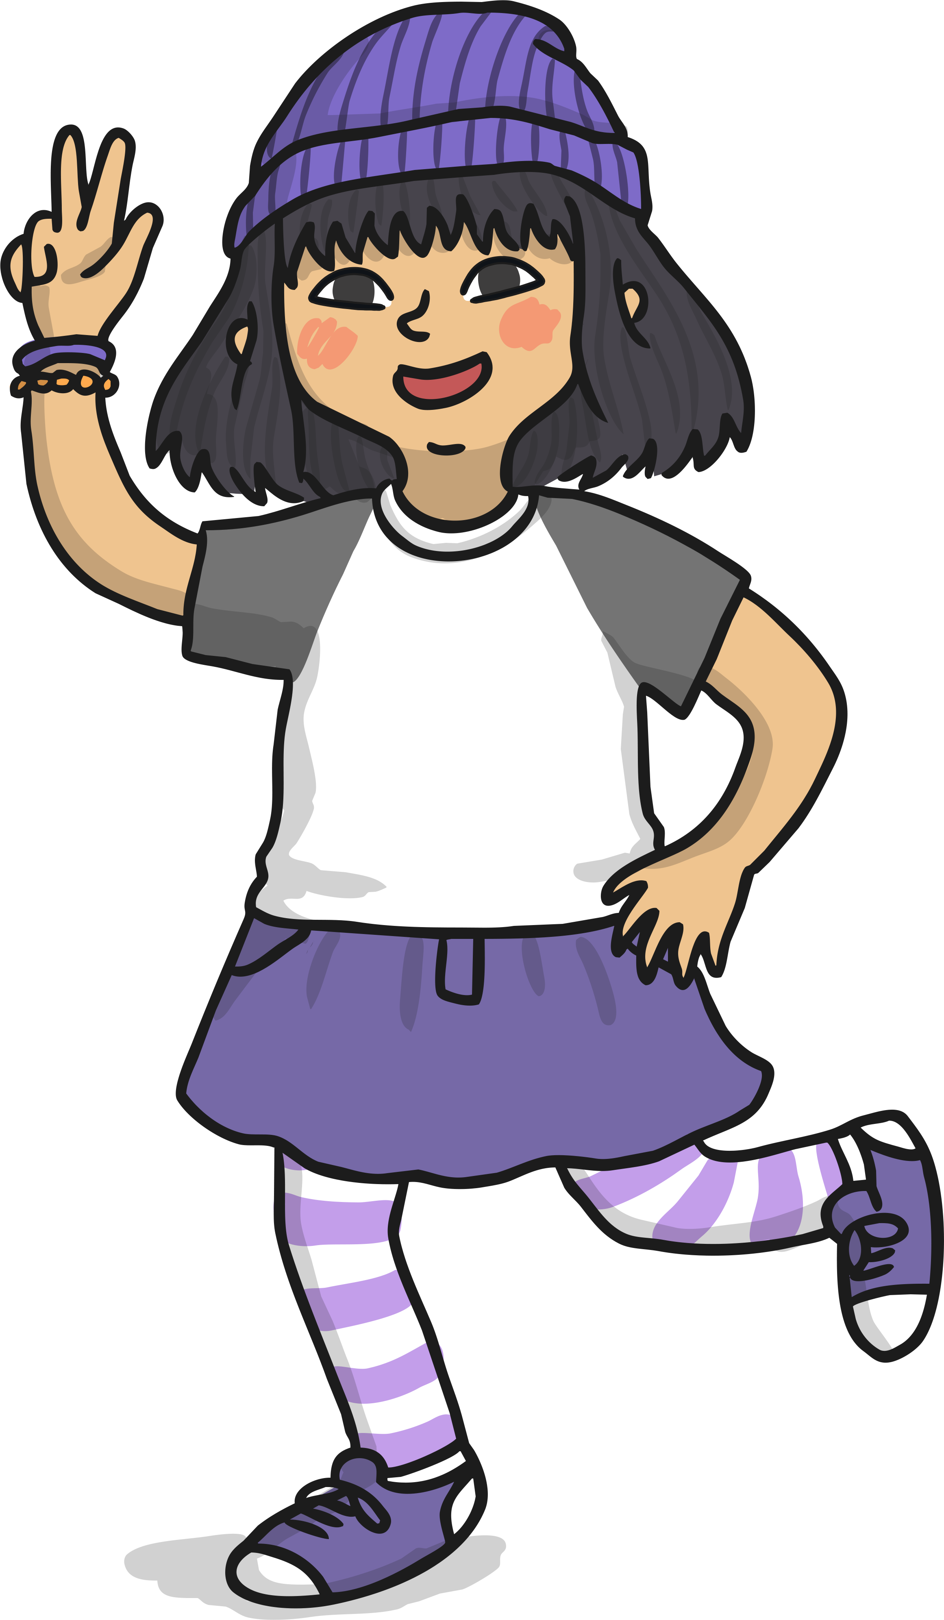
Rule
If a word has a short vowel with more than one consonant after it, then add ‘-ed’.
Can you think of some words like this?

Slide 7
Short Vowel Sounds With More Than One Consonant
back
ba
ck
ed
backed
pick
pi
ck
ed
picked
hand
ha
nd
ed
handed
hunt
hu
nt
ed
hunted
bank
ba
nk
ed
banked
lift
li
ft
ed
lifted

Slide 8
Rule
If a word ends in ‘e’ then just add ‘d’.

Slide 9
Just Add ‘d’ to Words Ending in ‘e’
hope
hop
e
d
hoped
joke
jok
e
d
joked
fake
e
fak
d
faked
tune
tun
e
d
tuned
fine
fin
e
d
fined

Slide 10

Rule
If a word has a long vowel sound, then add -ed.

Slide 11

Words With Long Vowel Sounds
look
look
ed
looked
cheat
cheat
ed
cheated
float
float
ed
floated
boil
boil
ed
boiled
sail
sail
ed
sailed
snow
snow
ed
snowed

Slide 12

Rule
If a word ends in a consonant followed by a ‘y’, then change the ‘y’ to an ‘i’ and add ed.

Slide 13
Words With Long Vowel Sounds
carr
ed
carry
i
carried
repl
ed
reply
i
replied
marr
ed
marry
i
married
stud
ed
study
i
studied
suppl
ed
supply
i
supplied

Slide 14
Rules for Adding ‘-ed’
Short vowel sound with one consonant, double the consonant and add ‘-ed’
lap
p
ed
Short vowel with more than one consonant after it, then add ‘-ed’.
ed
back
If a word ends in ‘e’ then just add ‘d’.
hope
d
look
If a word has a long vowel sound, then add ‘-ed’.
ed
If a word ends in a consonant followed by a ‘y’, then change the ‘y’ to an ‘i’ and add ‘-ed’.
carr
i
ed

Slide 15


What is the Rule?
Talk with a partner to decide which rule to use.
leak
Well done!
double the consonant and add ‘-ed’
drop the ‘y’ and add ‘i’ before adding ‘-ed’
Try again!
Try again!
Try again!
add ‘-ed’
add ‘-ed’
add ‘d’

Slide 16
What is the Rule?
Talk with a partner to decide which rule to use.
tap
Well done!
double the consonant and add ‘-ed’
Try again!
Try again!
double the consonant and add ‘-ed’
drop the ‘y’ and add ‘i’ before adding ‘-ed’
Try again!
add ‘-ed’
add ‘d’

Slide 17
What is the Rule?
Talk with a partner to decide which rule to use.
copy
Well done!
double the consonant and add ‘-ed’
drop the ‘y’ and add ‘i’ before adding ‘-ed’
Try again!
Try again!
Try again!
drop the ‘y’ and add ‘i’ before adding ‘-ed’
add ‘-ed’
add ‘d’

Slide 18

What is the Rule?
Talk with a partner to decide which rule to use.
pile
Well done!
Try again!
Try again!
double the consonant and add ‘-ed’
drop the ‘y’ and add ‘i’ before adding ‘-ed’
Try again!
add ‘-ed’
add ‘d’
Add ‘d’

Slide 19

What is the Rule?
Talk with a partner to decide which rule to use.
list
Well done!
double the consonant and add ‘-ed’
drop the ‘y’ and add ‘i’ before adding ‘-ed’
Try again!
Try again!
Try again!
add ‘-ed’
add ‘-ed’
add ‘d’

Slide 20
Click on a word to check
Sort these words into the grid below:
melt
snow
fan
skipped
paint
cope
hurry
tune
chat
try
time
worry
add ‘-ed’ | double the consonant and add ‘-ed’ | drop the ‘y’ and add ‘i’ before adding ‘-ed’ | add ‘d’
melted
fanned
hurried
coped
snowed
skipped
worried
tuned
painted
chatted
tried
timed

